Slide 1
3D Display Methods
<number>

Slide 2
Contents
3D Display
Definition & Types
Projection Types
Parallel Projection
Definition & Types
Perspective Projection
Definition & Types
Depth Cueing
Visible Line & Surface Identification
Surface Rendering
<number>

Slide 3
3D Display Methods
3D graphics deals with generating and displaying three dimensional objects in a two-dimensional space(eg: display screen).
In addition to color and brightness, a 3-D pixels adds a depth property that indicates where the point lies on the imaginary z-axis.
To generate realistic picture we have to first setup a coordinate reference for camera. This co-ordinate reference defines the position and orientation for the plane of the camera.
<number>

Slide 4
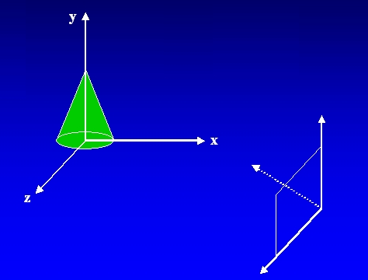
3D Display Methods Contd..
This plane used to display a view of the object
Object description has to transfer to the camera reference co-ordinates and projected onto the selected display plane.
<number>

Slide 5
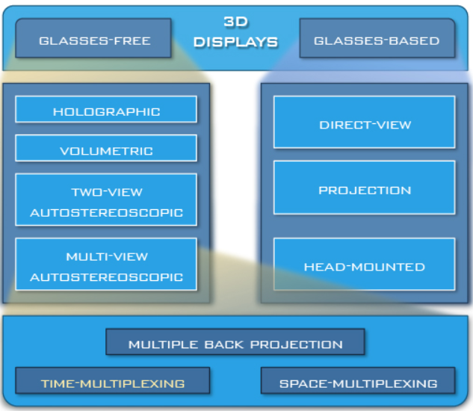
Types
<number>

Slide 6
Types of Projections
Transform 3D objects on to a 2D plane using projections
2 types of projections
Perspective
Parallel
<number>

Slide 7
PROJECTIONS
PARALLEL
(parallel projectors)
PERSPECTIVE
(converging projectors)
One point
(one principal vanishing point)
Orthographic
(projectors perpendicular to view plane)
Oblique
(projectors not perpendicular to view plane)
Two point
(Two principal vanishing point)
Axonometric
(view plane not parallel to principal planes)
General
Multiview
(view plane parallel to principal planes)
Cavalier
Three point
(Three principal vanishing point)
Cabinet
Isometric
Dimetric
Trimetric
<number>

Slide 8
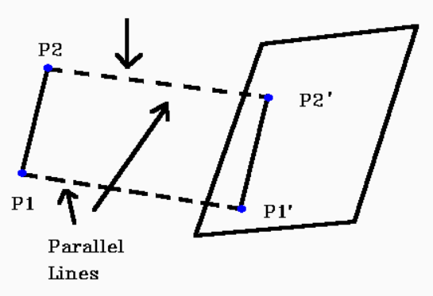
Parallel Projection
Discards z-coordinate and parallel lines from each vertex
Specify a direction of projection instead of center of projection
Project points on the object surface along parallel lines onto the display plane.
Parallel lines are still parallel after projection
<number>

Slide 9
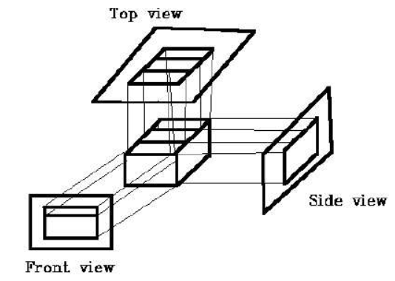
Parallel Projection: Types
1. Orthographic projection : If the direction of projection is perpendicular to the projection plane then it is an orthographic projection.
<number>

Slide 10
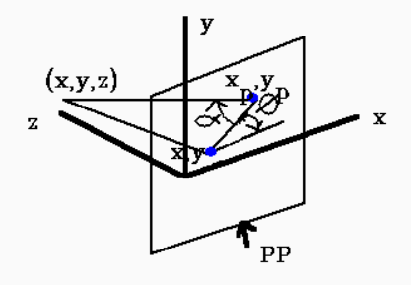
Parallel Projection: Types
2. Oblique projection : If the direction of projection is not perpendicular to the projection plane then it is an oblique projection.
<number>

Slide 11
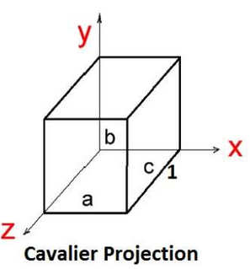
Oblique Projection: Types
Cavalier
The Cavalier projection makes 45° angle with the projection plane. The projection of a line perpendicular to the view plane has the same length as the line itself in Cavalier projection.
<number>

Slide 12
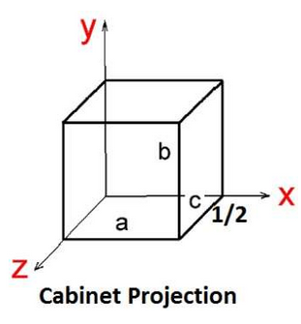
Oblique Projection: Types
Cabinet
The Cabinet projection makes 63.4° angle with the projection plane. In Cabinet projection, lines perpendicular to the viewing surface are projected at ½ their actual length.
<number>

Slide 13
Perspective Projection
Project points to the display plane along converging paths.
This is the way that our eyes and a camera lens form images and so the displays are more realistic.
Parallel lines appear to converge to a distant point in the background.
Distant objects appear smaller than objects closer to the viewing position.
<number>

Slide 14
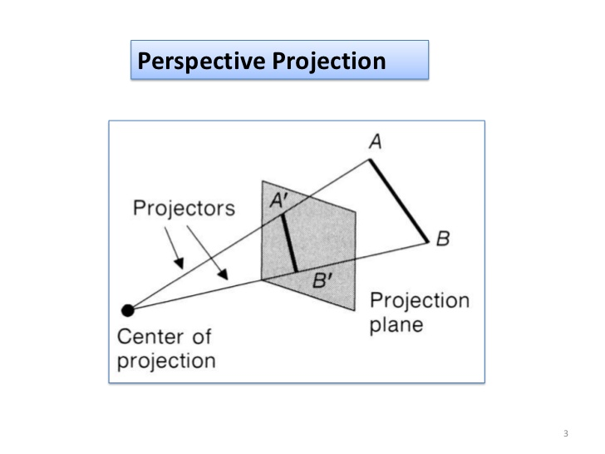
<number>

Slide 15
Types
One point perspective projection is simple to draw.
Two point perspective projection gives better impression of depth.
Three point perspective projection is most difficult to draw.
<number>

Slide 16
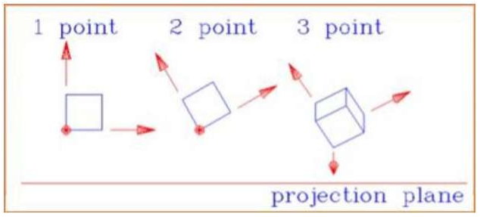
<number>

Slide 17
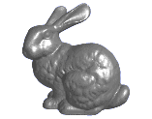
Perspective Projection
When we do 3-D graphics, we think of the screen as a 2-D window onto the 3-D world:
How tall should this bunny be?
<number>

Slide 18
Perspective Projection
The geometry of the situation is that of similar triangles. View from above:
View plane
X
P (x, y, z)
(0,0,0)
x’ = ?
Z
d
<number>

Slide 19
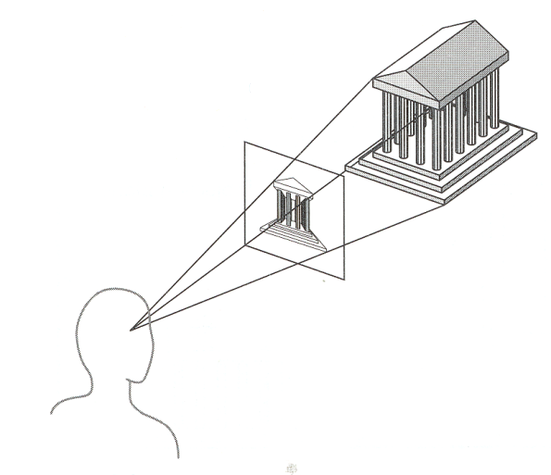
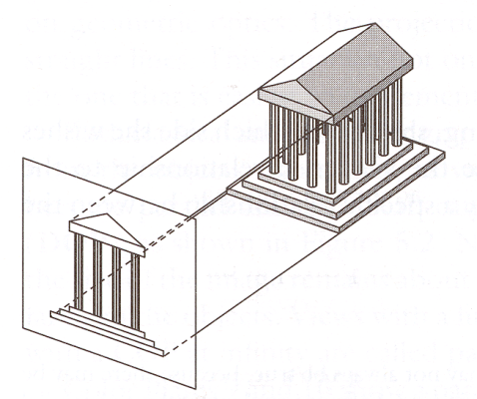
Perspective vs. Parallel
Perspective projection
Size varies inversely with distance - looks realistic
Distance and angles are not (in general) preserved
Parallel lines do not (in general) remain parallel
Parallel projection
Good for exact measurements
Parallel lines remain parallel
Angles are not (in general) preserved
Less realistic looking
<number>

Slide 20
Depth Cueing
To easily identify the front and back of display objects.
Depth information can be included using various methods.
A simple method to vary the intensity of objects according to their distance from the viewing position.
Eg: lines closest to the viewing position are displayed with the higher intensities and lines farther away are displayed with lower intensities.
<number>

Slide 21
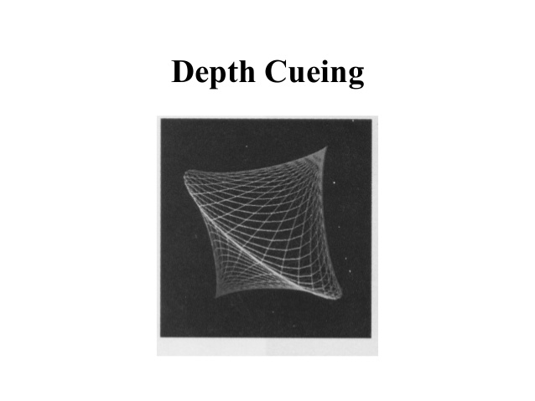
<number>

Slide 22
Visible Surface Identification
<number>

Slide 23
Classification of Visible-Surface Detection Algorithms
Mainly 2 types of approaches are followed
Object-space methods
Compares objects and parts of objects to each other
Image-space methods
Point by point at each pixel position on the projection plane
<number>

Slide 24
Comparison Between Methods
Object-space methods vs. Image-space methods
Object definition directly vs. their projected images
Most visible-surface algorithms use image-space methods
Object-space can be used effectively in some cases
Example: Line-display algorithms
<number>

Slide 25
Currently Most Used Approaches
Four algorithms:
Back-face elimination
Depth-buffer
Depth-sorting
Ray-casting
<number>

Slide 26
Surface Rendering
<number>

Slide 27
Definition
Rendering is the process of generating an image from a 2D or 3D model (or models in what collectively could be called a scene file) by means of computer programs.
Surface rendering involves the careful collection of data on a given object in order to create a three-dimensional image of that object on a computer. It is an important technique used in a variety of industries.
One of the techniques to construct an image using surface rendering is with illumination.
<number>

Slide 28
Uses:
Surface rendering is used in a number of industries, such as in health care. There, parts of the body are rendered so doctors can closely examine specific areas of a patient or wounds they may have incurred.
Archaeologists also use rendering to make an image of very fragile objects in order to examine them without harming them.
<number>

Slide 29

Any Questions??
<number>

Slide 30
Thank You
<number>

